Slide 1
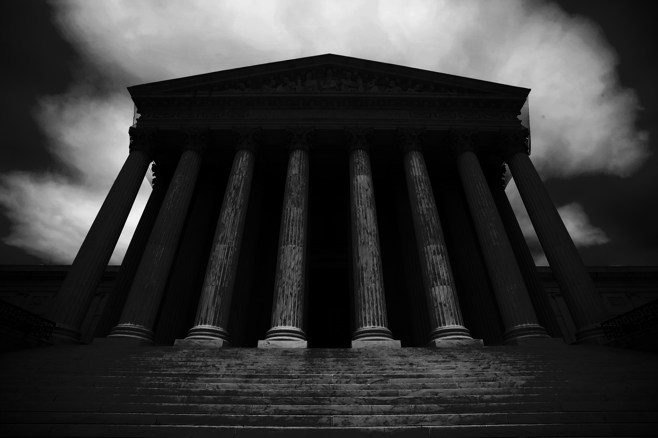
Predicting Supreme Court Decisions
Monica Rajendiran

Slide 2
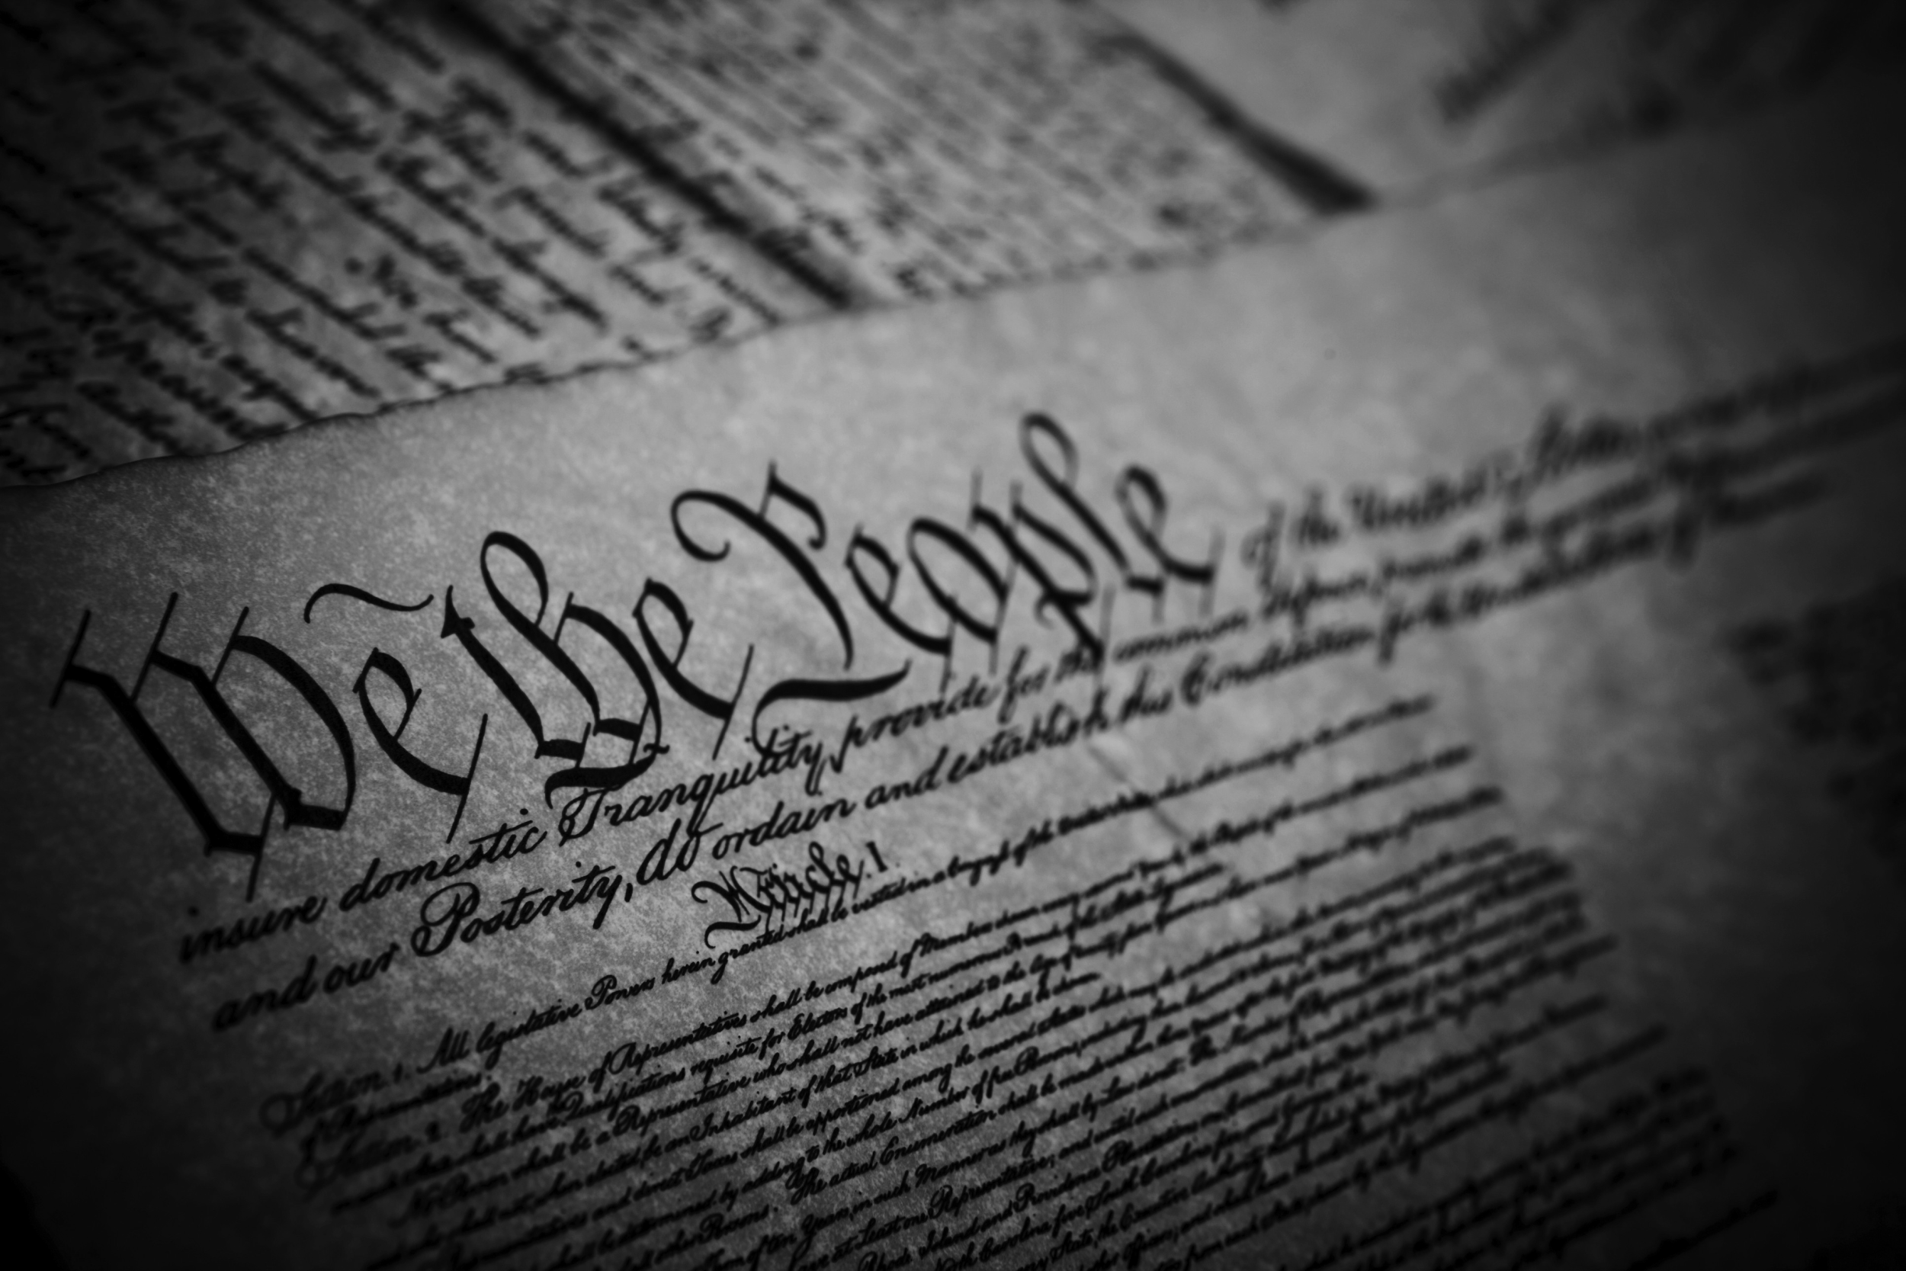
SCOTUS
U.S. Supreme Court
State Supreme Courts
Federal Appeals Courts
State Appeals Courts
Federal District Courts
State Trial Courts

Slide 3
Objective
Can we predict Supreme Court decisions using
historical and supplemental case data?
H_{o}: Case data (obtained from the Supreme Court Database) CANNOT predict the decision of the Supreme Court on a particular case (affirm or reverse judgement of lower court)
H_{a}: Case data (obtained from the Supreme Court Database) CAN predict the decision of the Supreme Court on a particular case (affirm or reverse judgement of lower court)

Slide 4
Data
Features | Description
Case Disposition (Response) | Affirmed (1) or Reversed (0) Judgement of Lower Court
Issue Area | Issue Case Pertains to (e.g. “2”: Civil Rights)
Majority Votes | Number of Justices Voting in Majority

Slide 5
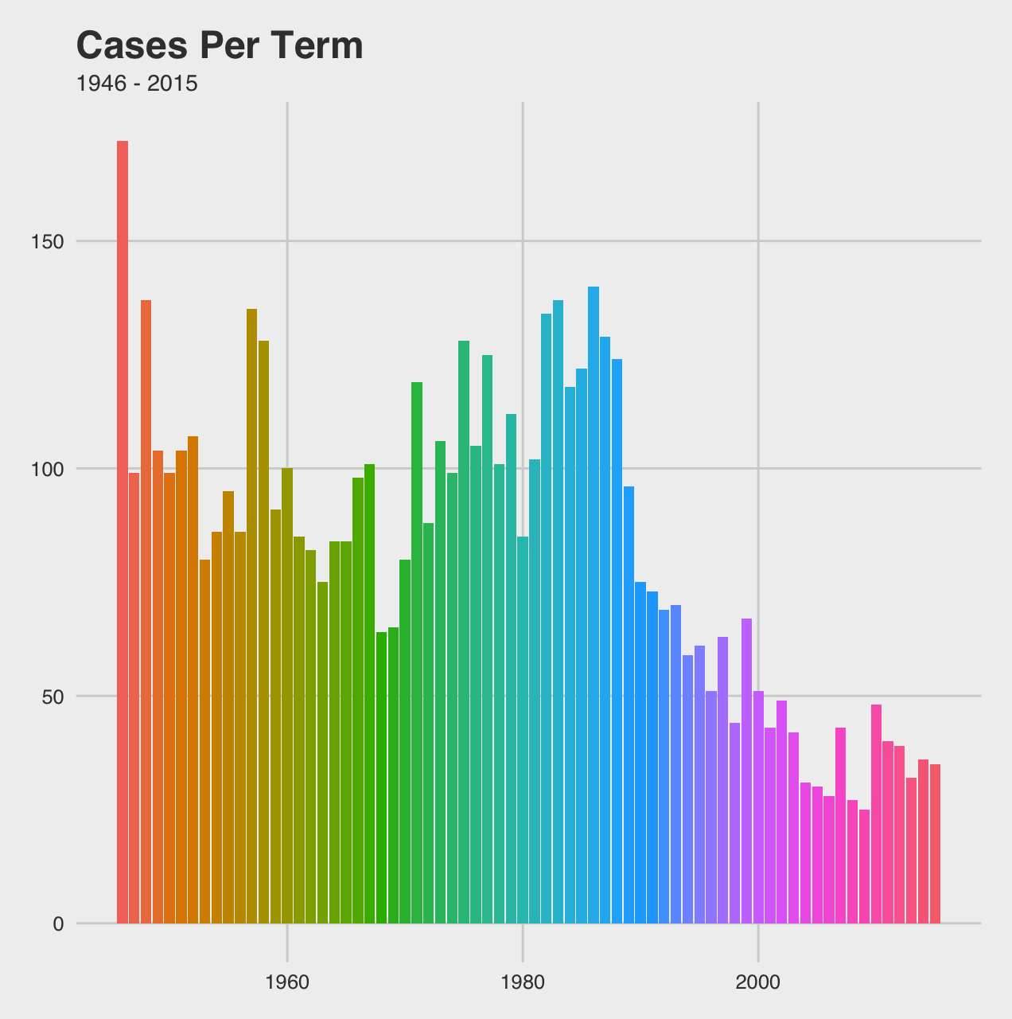
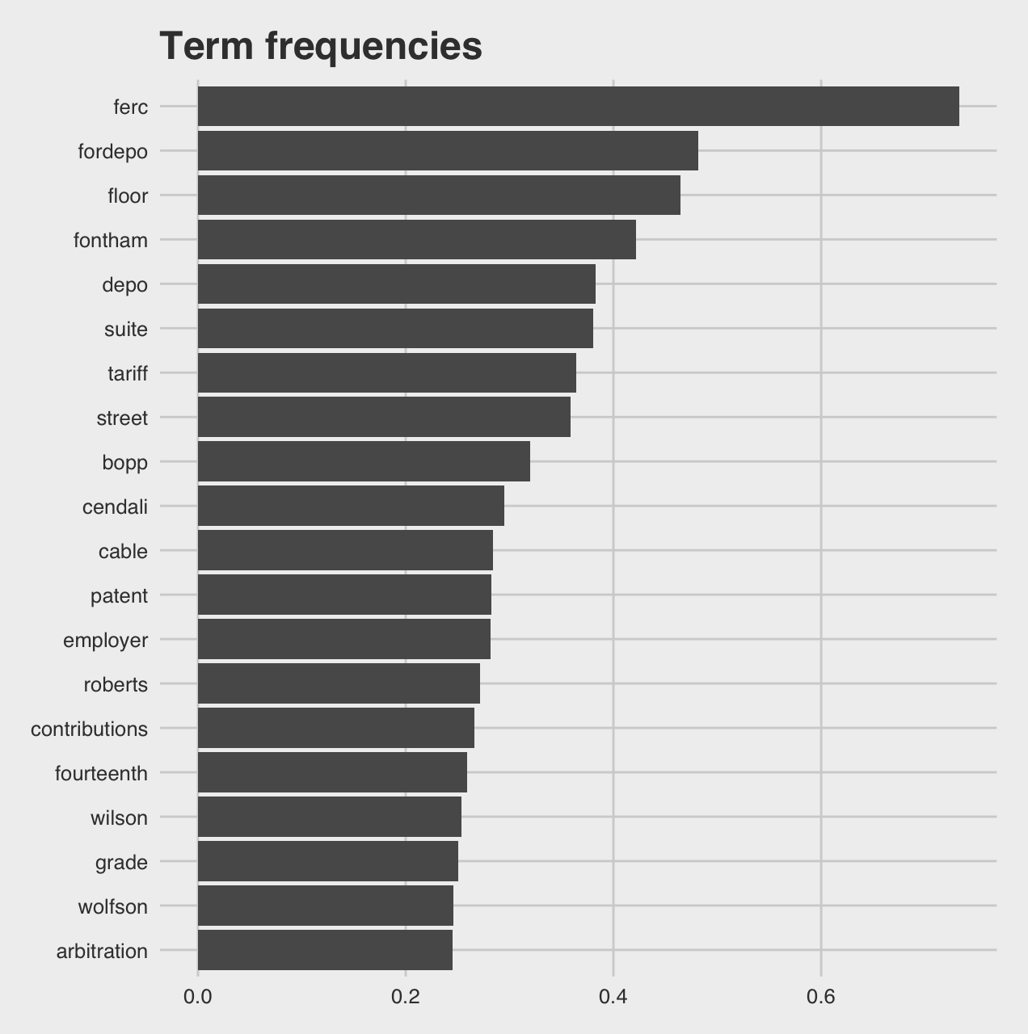
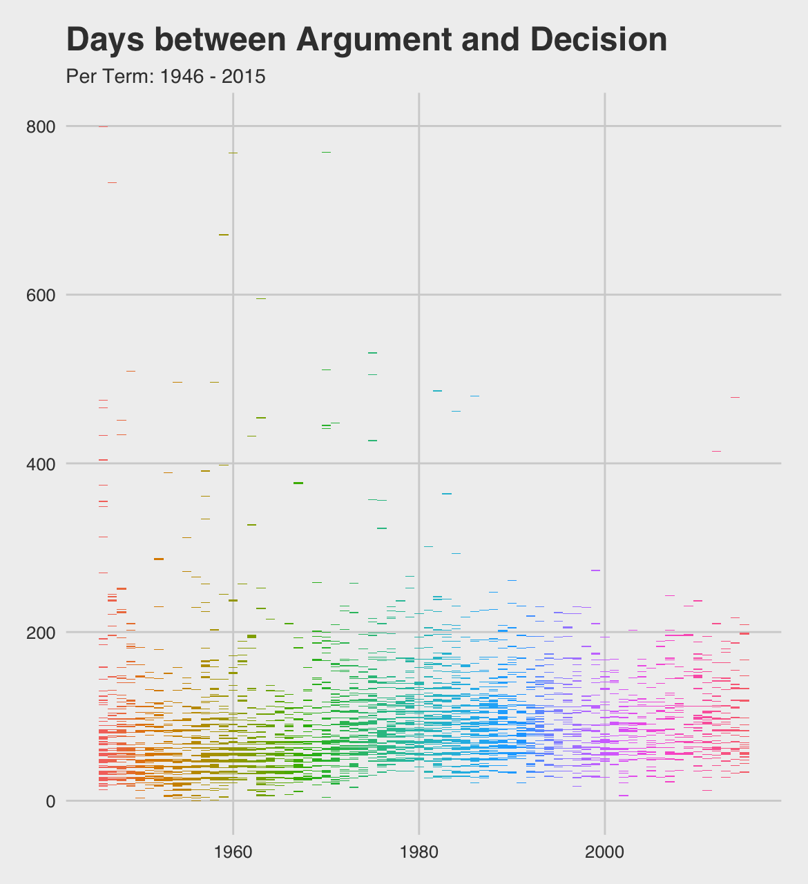
Exploring

Slide 6
Data
Engineered Features
Economy | Unemployment rate per term
Congress | Number of Democrats/Republicans in Senate/House
Time | Span (in days) between Oral Argument and Decision

Slide 7
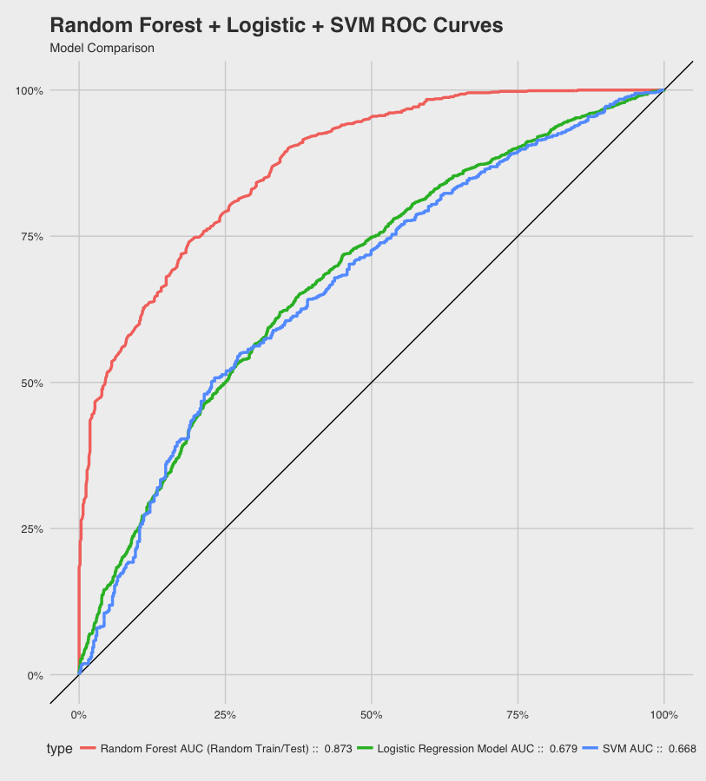
Modeling
Model | AUC
Random Forest | 0.87
Logistic | 0.67
SVM | 0.66

Slide 8
Modeling
Random Forest
Sensitivity | 0.6639
Specificity | 0.9203
Confusion Matrix
 | Reference
Pred. | 0 | 1
0 | 395 | 69
1 | 200 | 797

Slide 9
Conclusions
Hypothesis Supported
It appears we CAN satisfactorily predict decisions through historical case information
Extensions
Oral Arguments
Amicus Briefs
Justice Information
Join the SCOTUS Fantasy League!

